Slide 1
7.1.1
Specific Facilities
Provided to Women

Slide 2
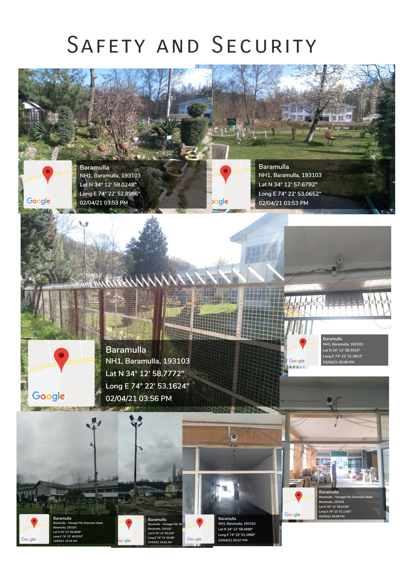

Slide 3
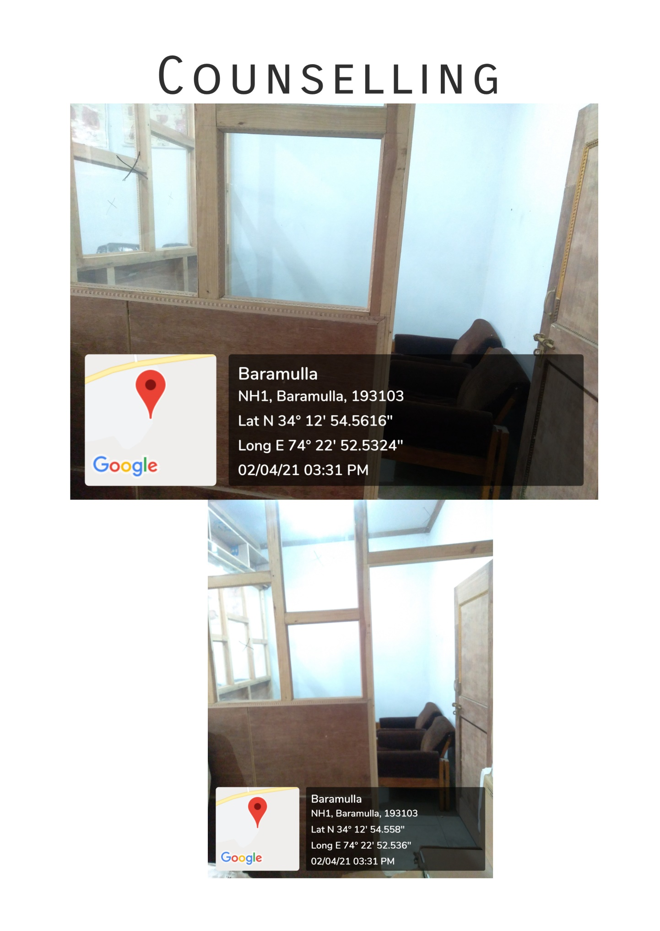

Slide 4
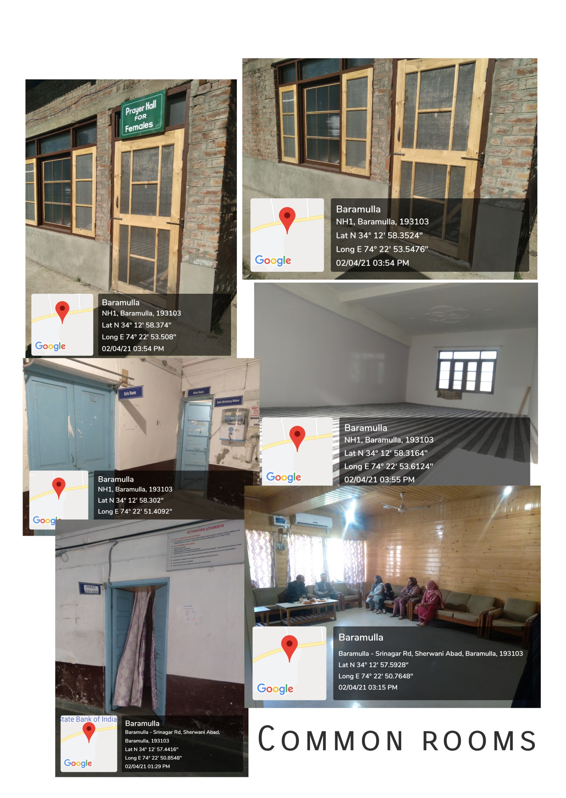

Slide 5
